Slide 1
Hands On Session 1: How to develop multiscale applications with MAD, MaMe and GridSpace Experiment Workbench?
K. Rycerz, E.Ciepiela, M.Pawlik, T.Gubała, D.Harężlak, J.Meizner, M.Bubak
03.06.13
CYFRONET

Slide 2
Plan
Objectives and Requirements
Idea of Multiscale Programming and Execution Tools
Short demo based on Fusion application by Olivier Hoenen, IPP, MPG, Germany
Hands on exercises

Slide 3
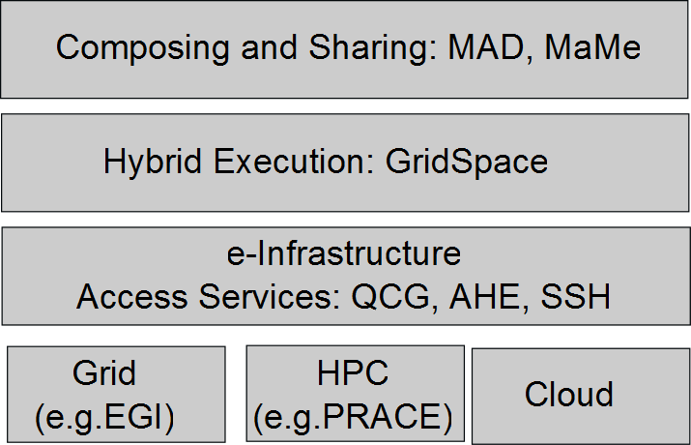
Objectives
Design and implement an environment for composing multiscale simulations from single scale models
  encapsulated as scientific software components
  distributed in various European e-Infrastructures
  supporting loosely coupled and tightly coupled paradigm
Support composition of simulation models:
  using scripting approach
  by reusable “in-silico” experiments
Allow interaction between software components from different e-Infrastructures in a hybrid way.

Slide 4
Requirements Analysis
Focus on the multiscale applications that can be described as a set of connected, but independent single scale modules and mappers (converters)
Support the variety of realizations of such applications in a unified way to:
  Enable sharing of simulation modules
  Support switching between different versions of the modules with the same scale and functionality;
  Simplifying verification of modules against different realisations
  Support building different multiscale applications from the same modules (reusability)
Support computationally intensive simulation modules
  requiring HPC and/or Grid resources,
  often implemented as parallel programs
Support tight (with loop), loose (without loop) or hybrid (both) connection modes

Slide 5
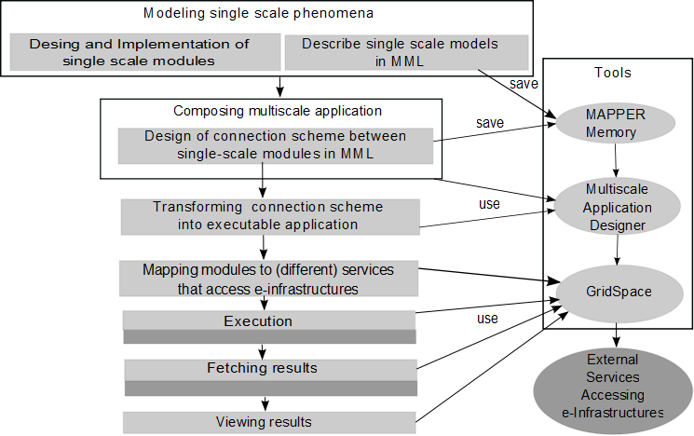
Building and Executing Multiscale Application
Process of constructing multiscale application consists of different steps
Most of these steps can be facilitated by:
  Multiscale Modeling Language (MML)
  programming and execution tools
  services accessing e-infrastructure

Slide 6
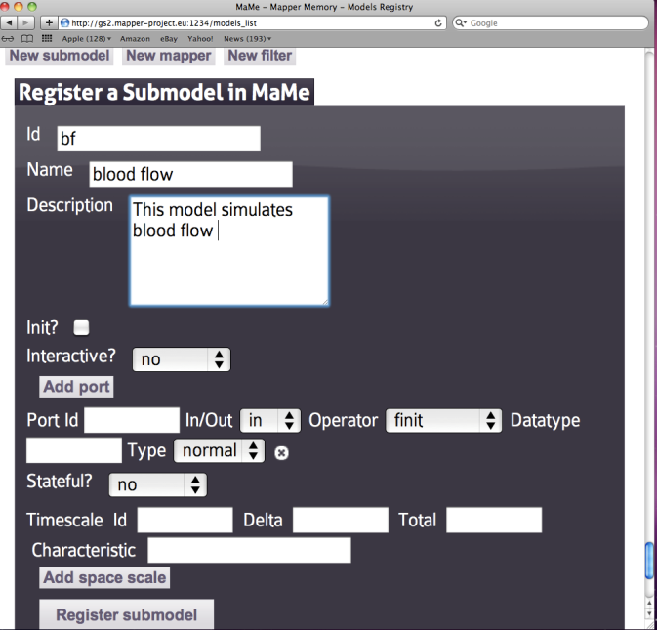
Mapper Memory (MaMe)
Semantics-aware persistence store
Records MML-based metadata about models and scales
Supports exchanging and reusing MML metadata for
  other MAPPER tools via REST interface
  human users within the Consortium via dedicated Web interface
Ports and their operators

Slide 7
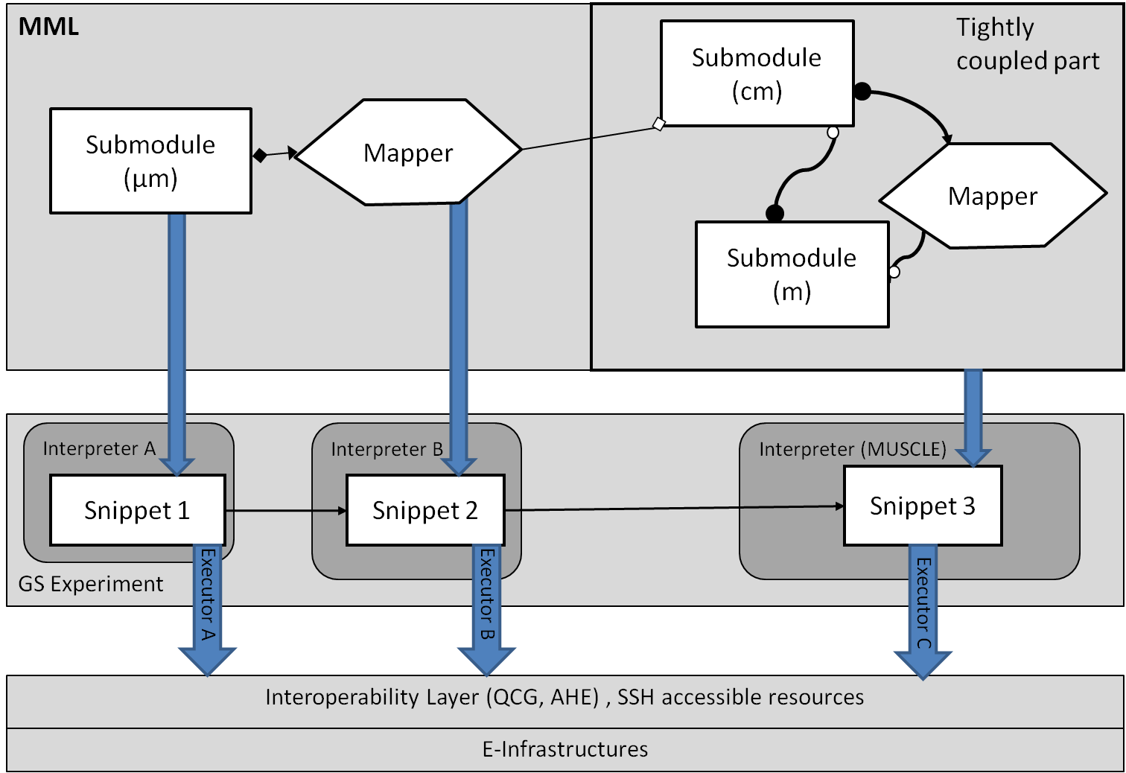
MultiscaleApplication Designer (MAD)
Supports composing multiscale applications from submodels and mappers registered in MaMe
Inport/export coupling topology represented in gMML to/from XMML file
Transforms high level MML description into executable experiment for GridSpace Experiment Workbench
MAD

Slide 8
GridSpace Experiment Workbench
Supports execution and result management of infrastructure independent experiments
Experiment - application composed of code fragments called snippets, expressed in:
  general-purpose scripting programming languages(Bash, Ruby, Perl etc.)
  domain-specific languages (CxA in MUSCLE, LAMMPS, Matlab etc)
Snippets are evaluated by respective programs called interpreters
Executors- responsible for snippets execution on various computational resources – servers, clusters, grid via
  direct SSH on UserInterface (UI) machine
  Interoperability layer (QCG, AHE)
Each snippet of the same experiment can be executed on different resource

Slide 9
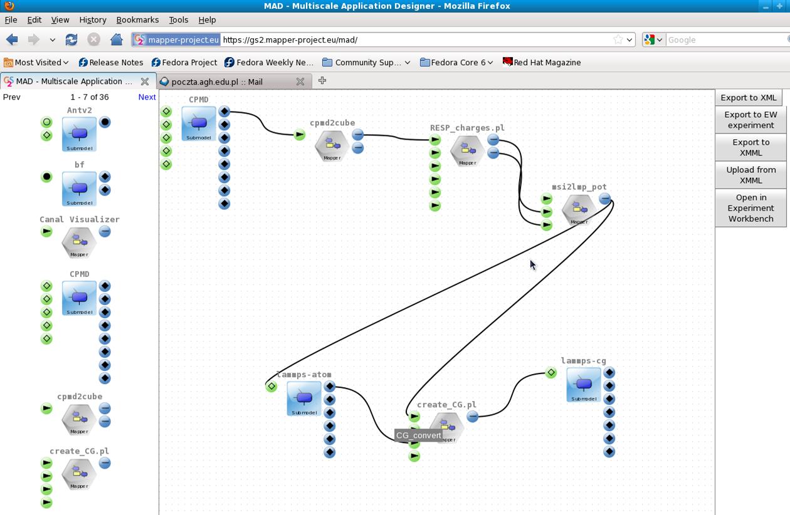
Loosely Coupled Example - Nano Polymer Simulation in MAD

Slide 10
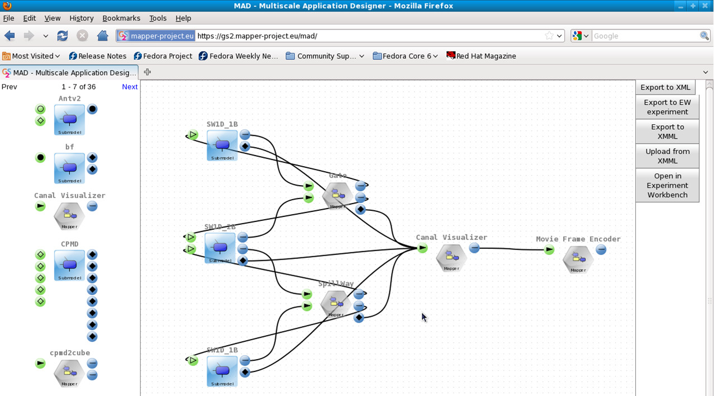
Tightly Coupled example – canal application

Slide 11
See also:
http://dice.cyfronet.pl
http://dice.cyfronet.pl/projects/details/Mapper
E. Ciepiela et al.: Exploratory Programming in the Virtual Laboratory, Proceedings of the International Multiconference on Computer Science and Information Technology p. 621–628, 2010
K. Rycerz and M. Bubak: Component Approach to Distributed Multiscale Simulations, SIMULTECH 2011, Noordwijkerhout, pp. 122-127, The Netherlands, 29-31 July, 2011
K. Rycerz et al.:Composing, Execution and Sharing of Multiscale Applications, submitted to Future Generation Computer Systems, in review

Slide 12
Fusion application demo

Slide 13
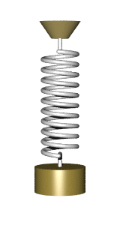
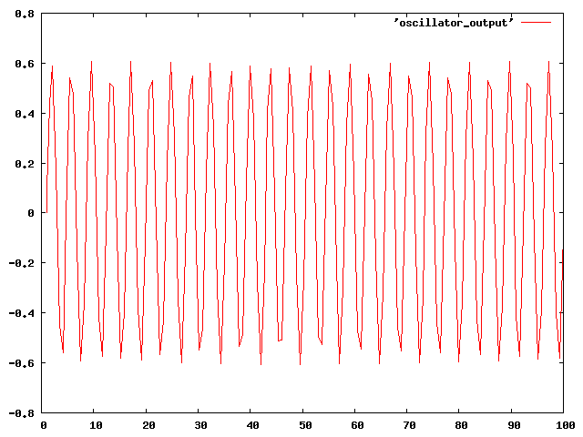
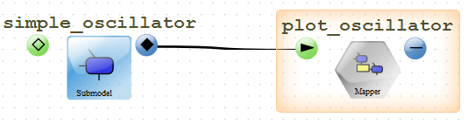
Hands on exercises - step1
http://www.mapper-project.eu/ -> Events, conferences, training->Multiscale Summer School-> Exercises & Hands on ->Hands On 1
Step 1 – simple oscillator simulation and plot
position(t)
weight
density

Slide 14

Hands on exercises – step 2
simple oscillator simulation and plot distributed
position(t)
GS Experiment
Python
Gnuplot
Snippet 1
Snippet 2
SSH
SSH
Zeus
Reef

Slide 15
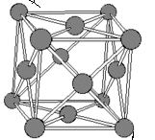
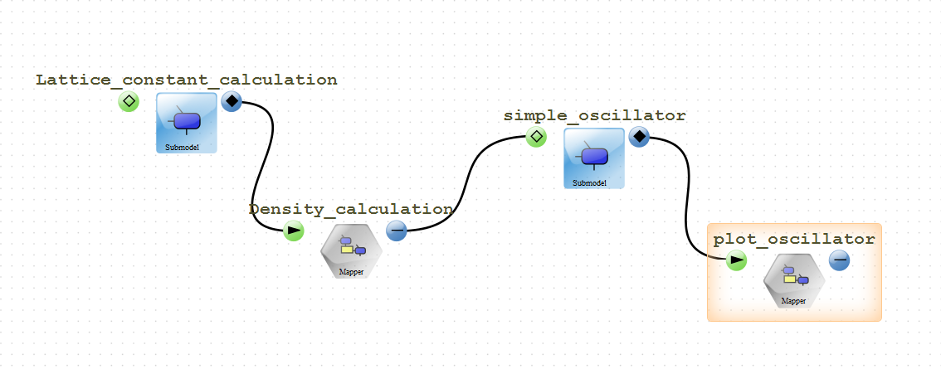
Hands on exercises – step 3
Building multiscale application
Lattice constant
weight
density
position(t)
Lattice constant
2 density
potentials

